Slide 1

Project Report on High School Lab Inventory Management System
Department of ICT and Engineering Zetech University
NICHOLAS KAVOI
Lecture, DEPARTMENT OF ICT Zetech University
Submitted By
Eugene Kimani DIT-02-0130/2022
Department of ICT and Engineering Zetech University

Slide 2
ACKNOWLEDGEMENT
This project ― “High School Lab Inventory Management System” has​ offered me accumulated knowledge on Computer programming languages as well as their roles in impacting positively on good systems of management in Educational Institutions. I am submitting this project work to the ICT, Zetech University. My gratitutde goes to my guide Mr Nicholas Kavoi (Lecture, Department of ICT, Zetech University).​ His guidance and follow up during all the phases of this project provided me with valuable advice and continuous assessments that enabled its success. I was also challenged by the prospects that this Management System could offer in Local Hosting in schools.
Eugene Kimani
DIT-02-0130/2022

Slide 3
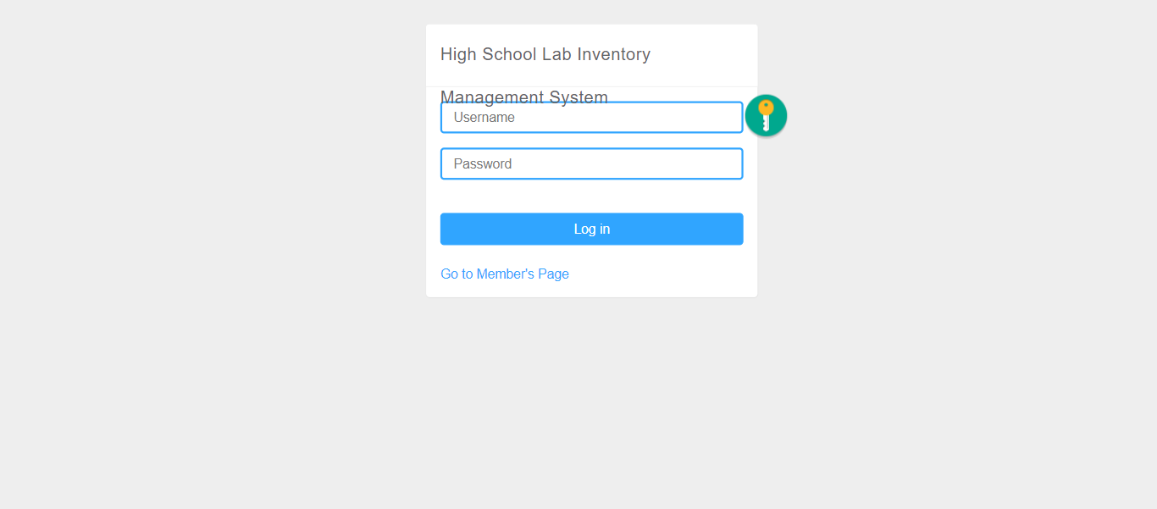
DASHBOARD
Notes:
This section contains log in information that allows the user to access the system. Some of the keys features include Username section, password section and a link “Go to Member’s Page” which directs the user to regain access to the system incase they loose the encryption key.

Slide 4
Objectives
I am supposed to build a High school Lab Inventory Management System.
I will be using MYSQL and PHP programming languages throughout this project. This system contains the following section panels:
The User Panel:
Allows admins, staff and students to access the system
This section is password protected
Notes:
The User panel is a password protected area that enables users to access the system using an enrollment key and password provided by the administrator during their registration. This is an interactive section that allows the user to access specific areas of the system hence ensuring security of the system is maintained at all times. User information is also encrypted.
The user can make reservations, borrow and return items to the Lab.

Slide 5
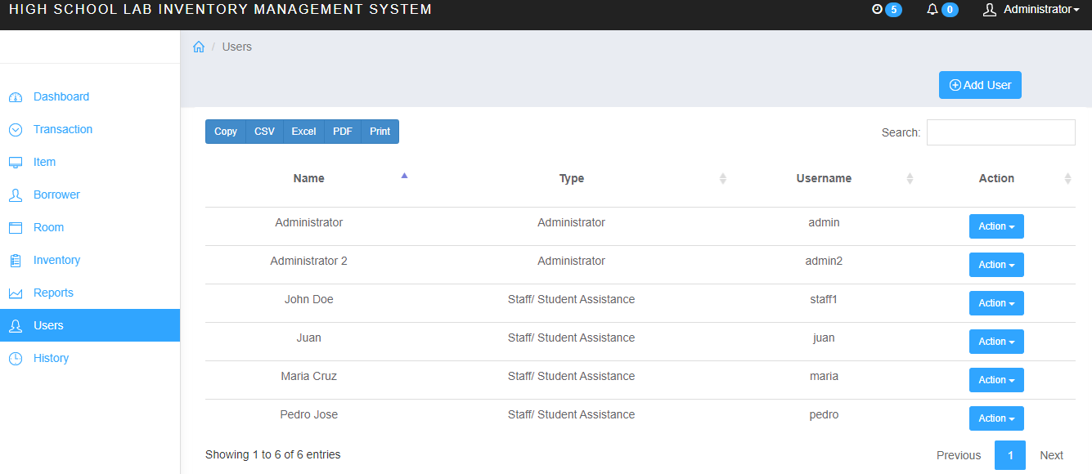
User Panel
Notes:
Other sections in the user panel include the Action area and a command section that enables the user to view the document in other forms. This section can also enable the administrator to collect and collate user information in an Excel format. The Action area enables the administrator to edit, deactivate or change passwords. This allows the administrator to have full access to the system and monitor user movement.

Slide 6
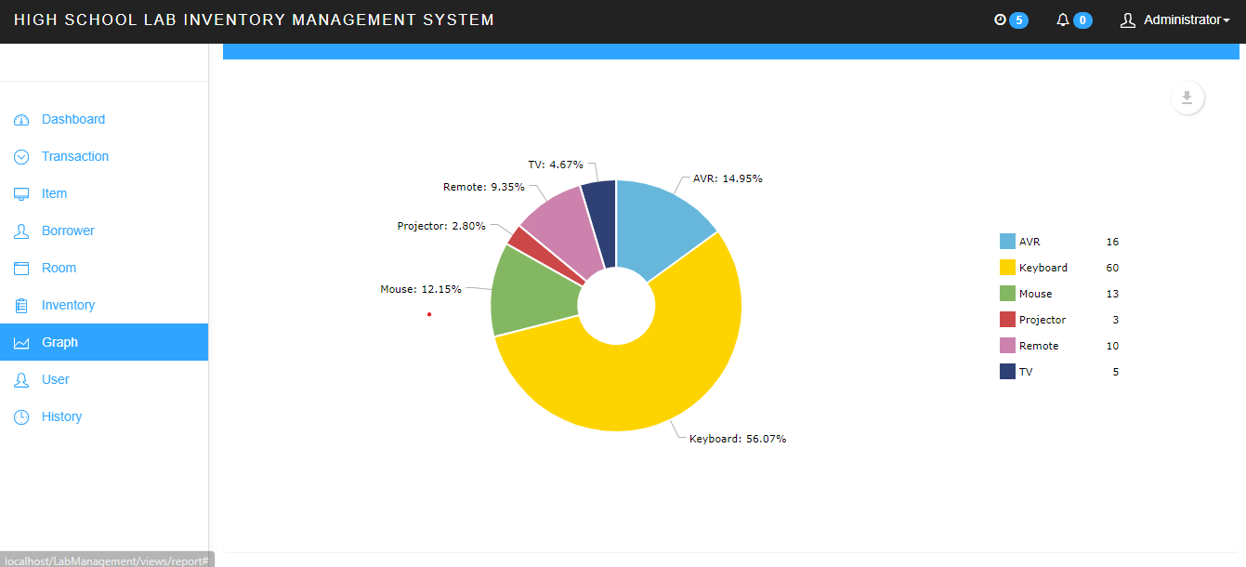
Graph panel
Notes:
The graph section contains graphical representation of each item used, borrowed or returned to the Lab. This allows the admin to keep track of items and understand user preference.

Slide 7
Inventory panel
It contains the following sections:
Model
Category
Brand
Quantity

Slide 8
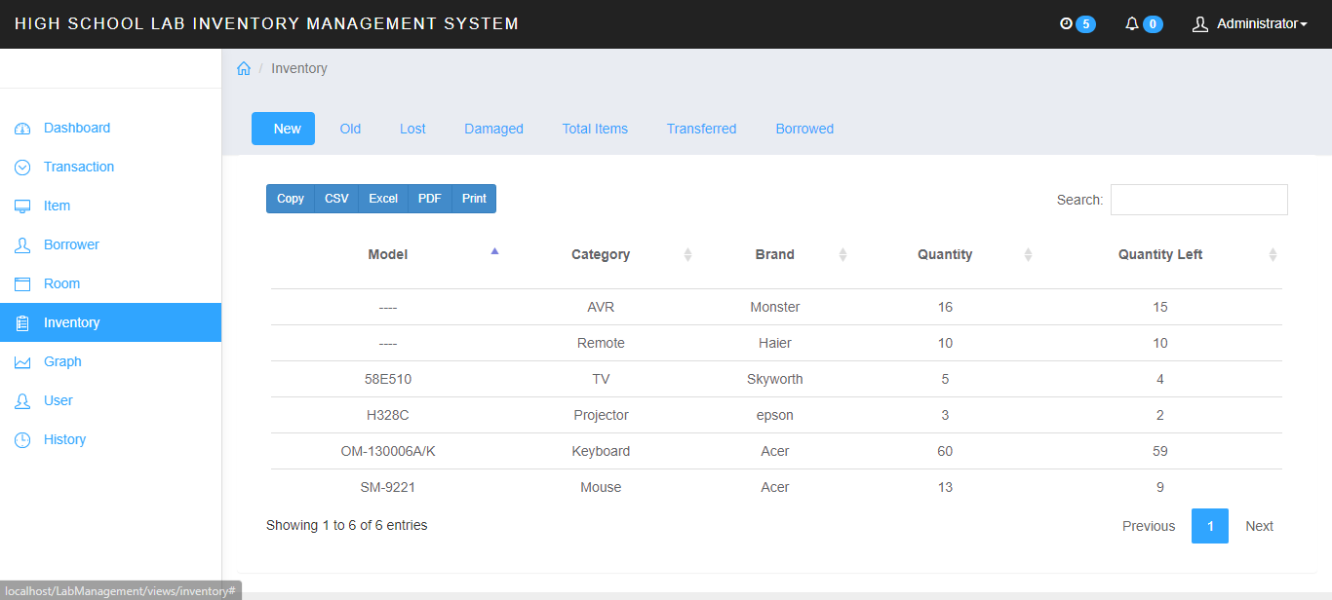
Inventory panel
Notes:
The inventory section for this system has columns that record specific information about the items. This section also enables the administrator to control full access of the inventory and monitor the items. This also enables the admin to check the status of the items if they are damaged or lost. This will allow the administrator to follow up the status of the item.

Slide 9
transaction Panel
Contains the following drop down menus:
Reservation section
New
Borrowed items
Returned items

Slide 10
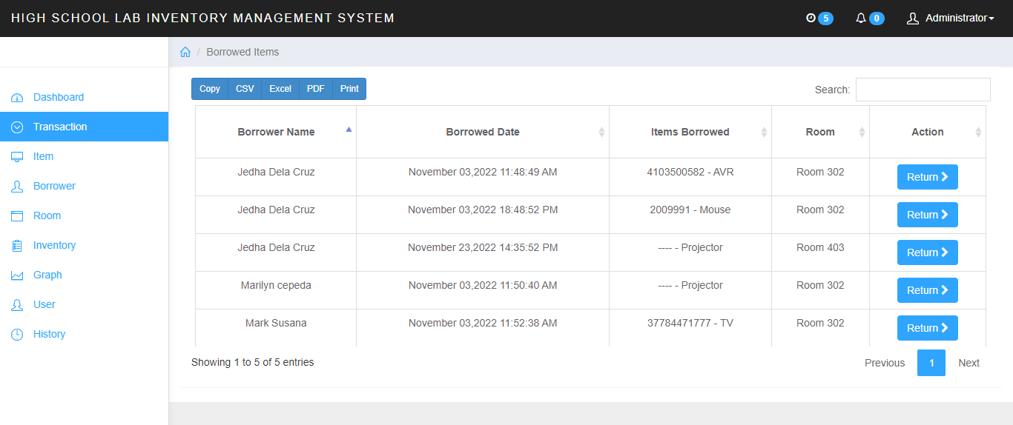
TRANSACTION PANEL
Notes:
The Transaction panel contain keys areas that helps to monitor movement of items . The Reservation section is an area where a user to book and add an item. This section captures user information such as name, item reserved, room allocated, date and action. The “New Section” allows the user to borrow items to a maximum of five. It also indicates room allocation and time limit of the borrower. The Borrowed Items section contain the borrower’s details such as name, Items borrowed, Date borrowed, room allocation and action taken. The Return section collates user information based on the items they have borrowed and returned.

Slide 11
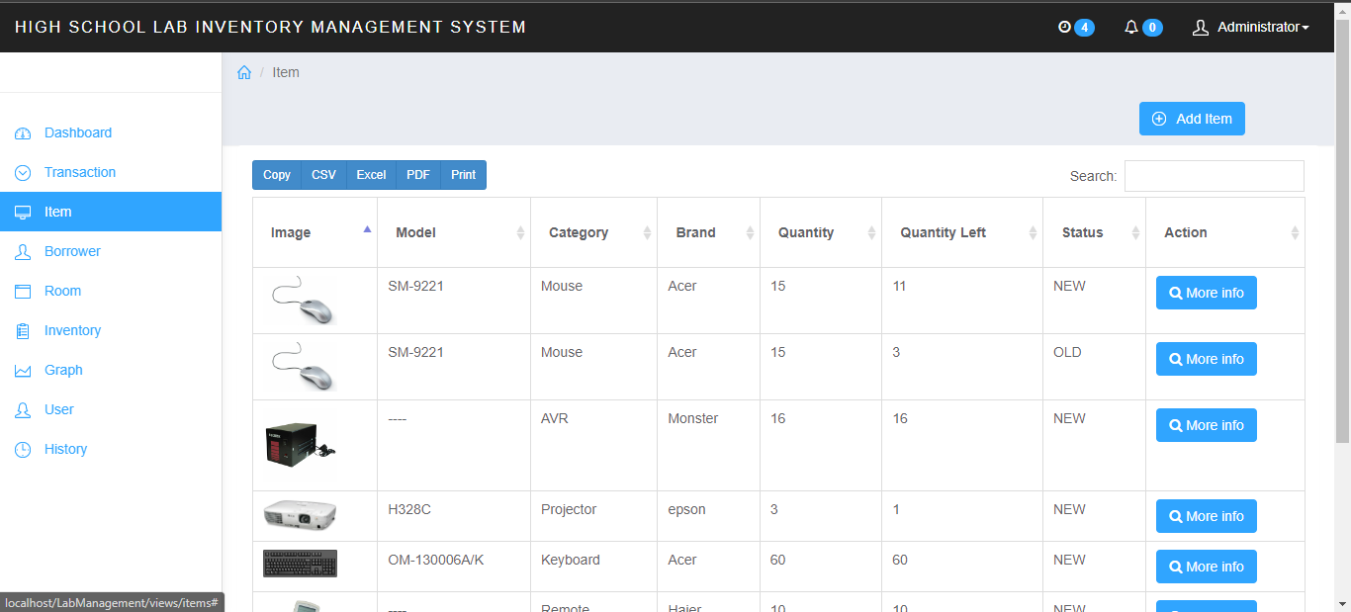
Item panel

Slide 12
Conclusion
This management system has the potential to serve a local host thanks to the guidance of my instructor.
Thank you…!
Designed by: Eugene Kimani DIT-02-0130/2022
Instructor’s Name: NICHOLAS KAVOI
Signature:________

